Slide 1

See the world around you!
Fun with Image Recognition & Serverless Bots
Mayank Kumar
@mayankdotnet

Slide 2

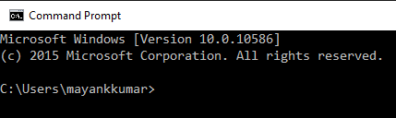
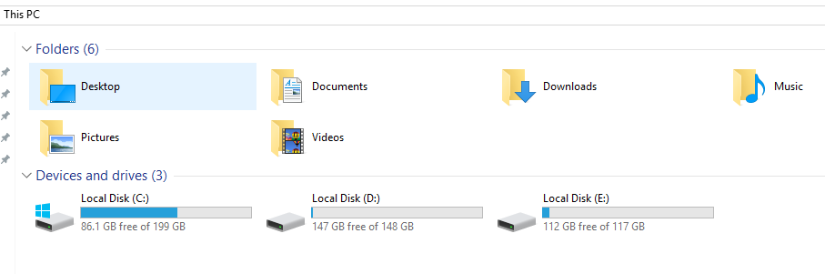
Evolution of Human/Computer Interface
Command Line Interface (CLI)
Graphical User Interface (GUI)
Natural User Interface (NUI)

Slide 3
Bot Framework Components
Bot Service
Bot Connector
Bot Builder SDK (.NET 4.6 & Node.js)
Hosting Options
Azure App Service (Web App)
Azure Functions (Serverless)

Slide 4
?
… great
How do you make a bot
First impressions matter! – Provide an engaging Welcome message
Your bot should have a personality
Do one simple thing – Nicely
Don’t spam your users
User should be in control – Always
Don’t try to hide the fact that this is a bot not a human

Slide 5
What is “Serverless”?
Abstraction of servers
Event-driven scale
Sub-second billing

Slide 6
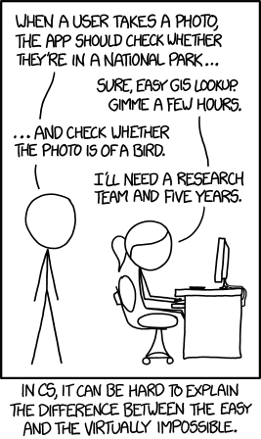
Computer Programming
In the 60s, Marvin Minsky assigned a couple of undergrads to spend the summer programming a computer to use a camera to identify objects in a scene. He figured they'd have the problem solved by the end of the summer. Half a century later, we're still working on it.
https://xkcd.com/1425/

Slide 7

Azure Cognitive Services
Vision API
Face API

Slide 8
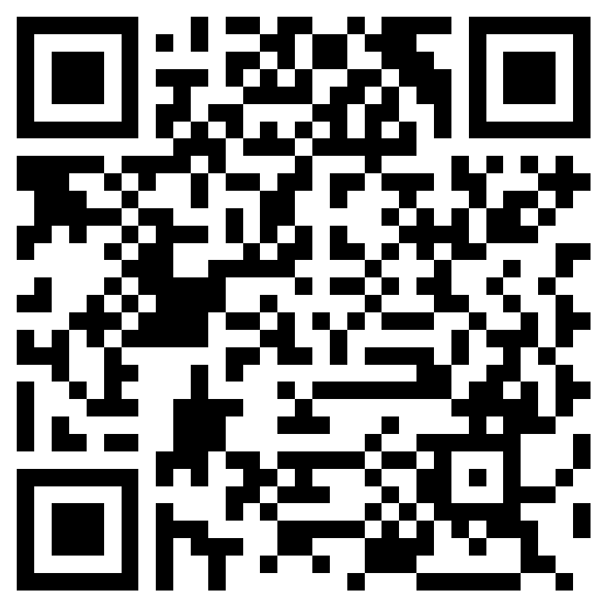
What are we building?
https://join.skype.com/bot/5a6b322e-10d3-4913-a777-7609aca3f592

Slide 9
What do we need?
Azure Function Bot
Azure Storage Account
Azure Vision API & C# SDK
Azure Face API & C# SDK
Visual Studio 2017

Slide 10
Reference Architecture

Slide 11
Code Repository
https://github.com/mayankthebest/hydbootcampbotdemo

Slide 12
Questions?

